Slide 1
Parameters identification method for ductile fracture with machine learning model
Sayoojya Prasad and Zinan Li
Aalto University
1/11/2023

Slide 2
Contents
Motivation
State of Arts
Case I: Anisotropic fracture (damage initiation indicator) prediction using LSTM
  General Workflow
  Data
  LSTM Architecture and Specifics in this Study
  Results
Case II: Damage parameters identification using ANN
  General Workflow
  Data
  ANN Architecture and Specifics in this Study
  Results
Outlooks

Slide 3
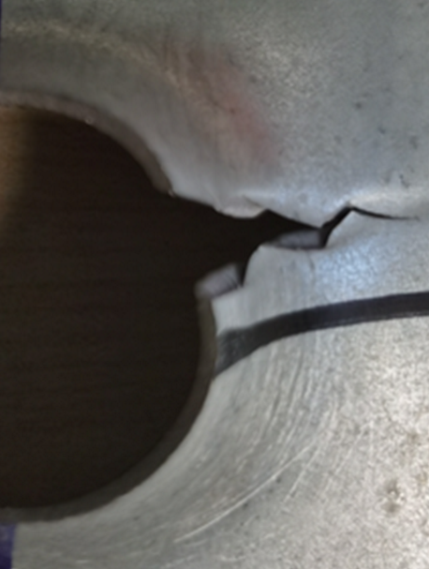
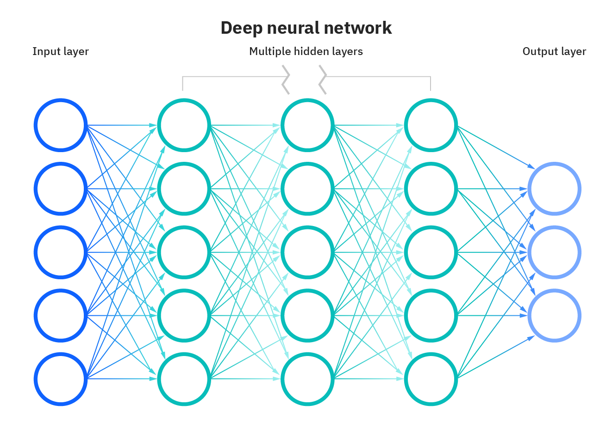
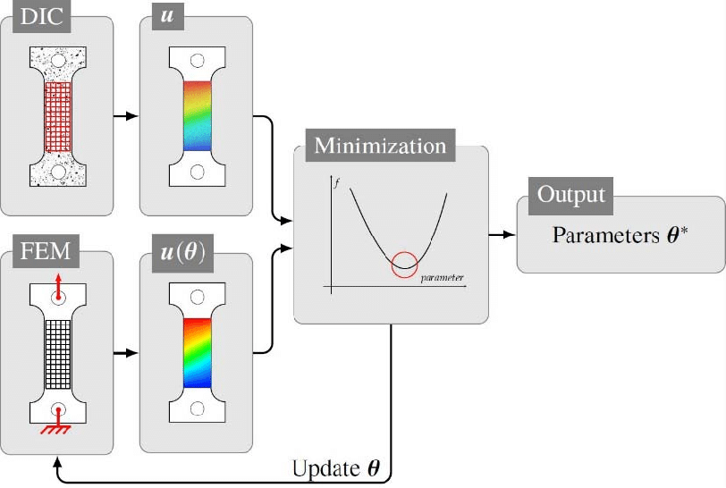
Motivation
Wide application of metal forming in the automotive industry – Fracture prediction
Inverse problem: damage parameters to be identified
Machine learning works more efficiently than traditional calibration methods
Performance of long-short term memory (LSTM) & artificial neural network (ANN) got validated in previous studies
Reference material: QP1000
Aim: Machine learning to identify damage parameters
Ductile fracture
Li, Z., et al. 2023
Inverse problem
Machine learning
Petureau, L, et al. 2019
https://www.ibm.com/cloud/learn/neural-networks

Slide 4
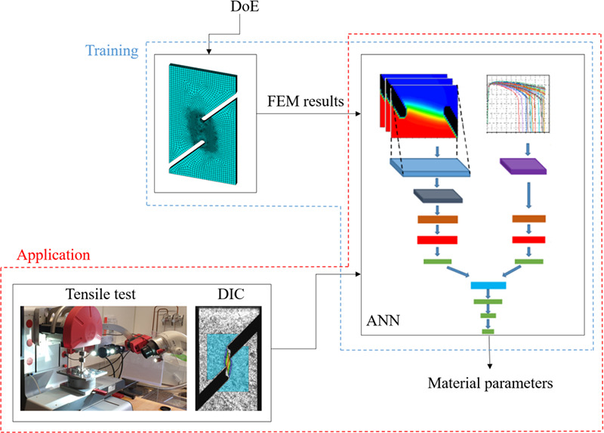
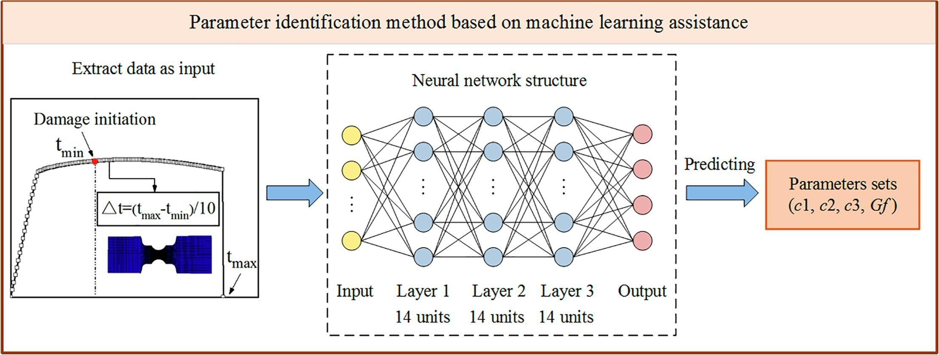
State of Arts
Machine learning assisted calibration of a ductile fracture locus model (A1050)
Fracture locus, three parameters
One geometry (shear) for training
CNN (pattern recognition for local strain concentration) + ANN
Inputs: displacement field images (in local area) + global F-D
Database 3×3×3, three-level full factorial experimental design
Outputs: material parameters, averaged over 10 optimized ones
Prediction accuracy similar to FEMU for other geometries
Baltic, S. et al. 2021
Parameter identification of the semi-coupled fracture model with ML assistance (6061)
Damage evolution, four parameters
One geometry (notched) for training
ANN 3 hidden layers (14 units per layer)
Inputs: strain field (critical point) + global F-D
Database 3×3×3×3
Outputs: material parameters
Predition accuracy overall good except for shear
Yao, D. et al. 2022

Slide 5
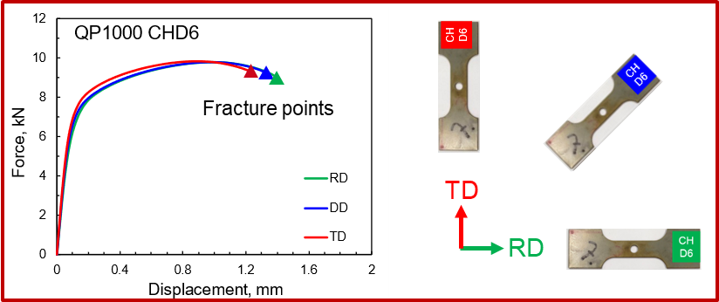
Case I: Anisotropic Fracture prediction using LSTM
Anisotropic fracture
Variation along different directions
Why LSTM?
  Sequential data – evolution of the damage initiation indicator
  History inputs for present
3 directions × 4 geometries - takes into account the anisotropic and stress state effects
Inputs: Strain components {LE11, LE12, LE13, LE22, LE23, LE33}, Lode angle and stress triaxiality
Outputs: Damage Initiation Indicator (DII)
DII~1

Slide 6
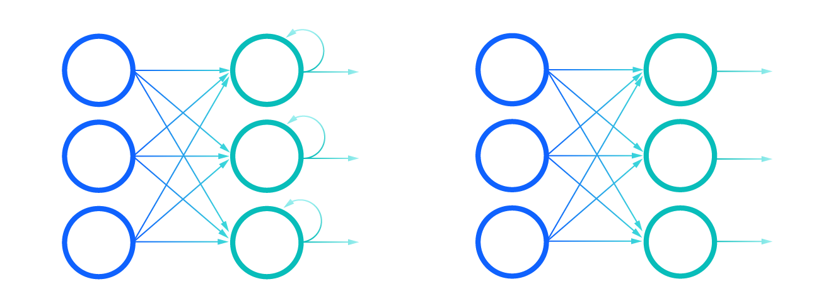
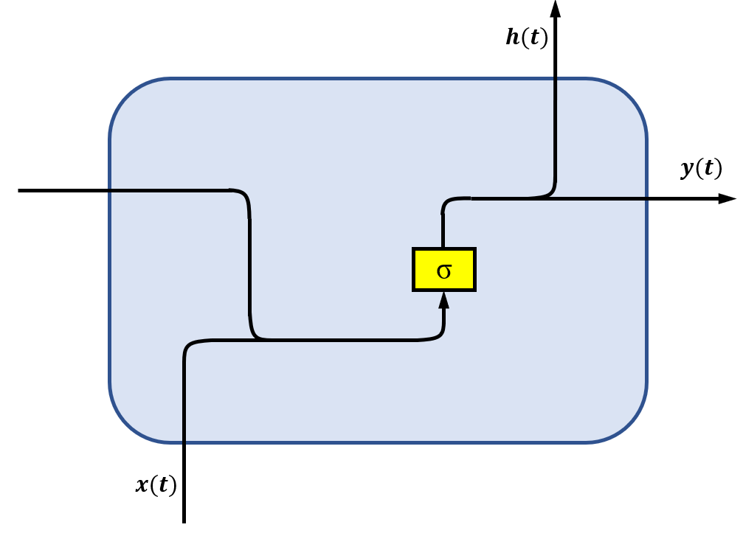
Long Short Term Memory and RNN
RNN (recurrent neural network) : used to model temporal data
They use their internal state (or memory) to process sequence of inputs (unlike feed-forward ANN)
Information from previous time steps/inputs used for prediction in current time step : interdependencies in sequential data is taken into account
Chain-like structure, hidden state carries info through the chain
RNN works well for short sequences
RNN vs ANN
https://www.ibm.com/cloud/learn/recurrent-neural-networks
A simple RNN architecture

Slide 7
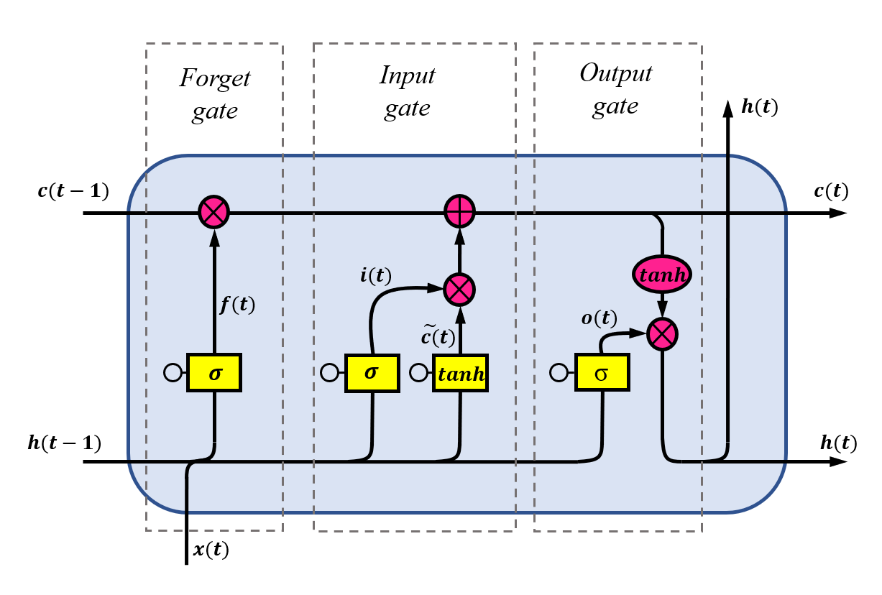
Long Short Term Memory and RNN
Similar structure as RNN
Key point: cell state that runs through the entire chain
LSTM can add or remove information in the cell state through different gates in each unit
1st step: what information should be removed
2nd step: what information should be stored
  Which values need to updated
  Which new values need to be added
3rd step: output of the unit is computed
This way, only necessary information is retained, and useless information is discarded.
Helps to model longer sequences

Slide 8
Bayesian Optimization
Method for Hyperparameter Tuning
Probabilistic model-based optimization technique
Useful for hyperparameter tuning for complex functions like running an LSTM model
Keeps track of past evaluation results to form a probabilistic model
Objective function: takes in a set of hyperparameters and outputs a score -> maximise
Surrogate model p(y | x) : probabilistic model based on past evaluation results -> easier to optimize
Only need to make fewer calls to the objective function -> very time efficient
Acquisition function: to decide which hyperparameters to evaluate next -> exploration vs. exploitation
Iterative process until termination

Slide 9
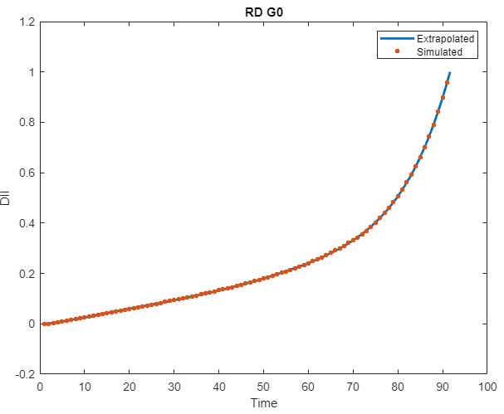
Database
Total 12 simulation data available for 3 directions and 4 geometries
Geometry | Rolling Direction
 | RD | TD | DD
G0 | ✓ | ✓ | ✓
G1 | ✓ | ✓ | ✓
G2 | ✓ | ✓ | ✓
G3 | ✓ | ✓ | ✓
✓ Training
✓ Testing
The data extracted from simulations were not very smooth and the simulation stopped when the DII reached close to 1
Therefore, data smoothening and extrapolating to reach DII value of exactly 1
Each simulation now contains 100 data points with varying intervals
Curve fitting tool – MATLAB

Slide 10
LSTM Architecture and Specifics in this Study
Input layer
(8 units)
Inputs/Features: 6 strain components, lode angle, stress triaxiality
Outputs/Labels: DII
Data normalization
Hyperparameter tuning: to optimize right number of units per layer: Bayesian Optimization
Number of epochs (total number of iterations of training data): 200
Batch size (number of data samples processed before adjusting weights and biases): 16
Dropout layers: (to prevent overfitting) 0.1
Activation function (function to evaluate the output of a node/unit): RelU
Loss function (function to evaluate how close the predicted and real outcomes are): Mean squared error
1st hidden layer
(132 units)
Dropout layer: 0.1
2nd hidden layer
(239 units)
Dropout layer: 0.1
3rd hidden layer
(64 units)
Output layer
(1 units)
LSTM
Architecture

Slide 11
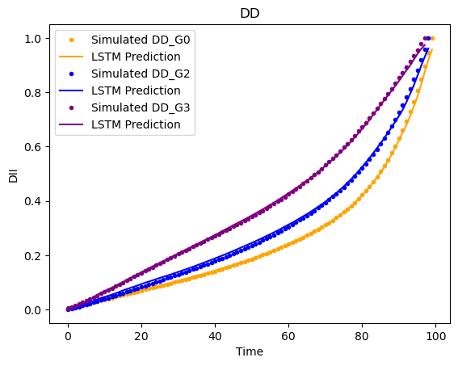
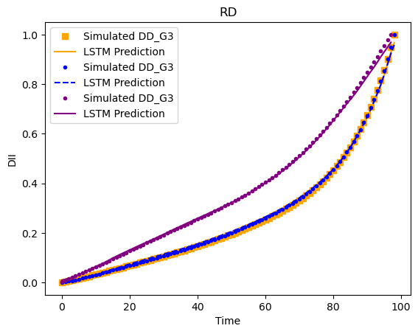
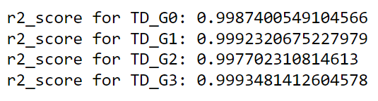
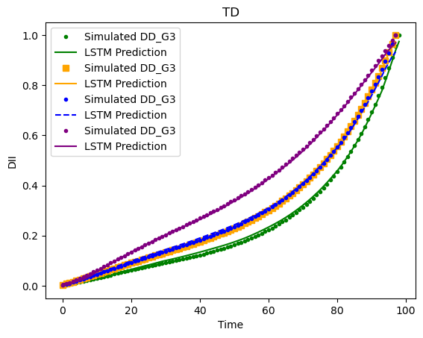
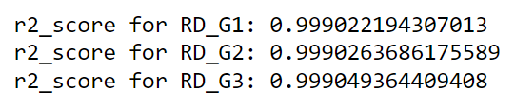
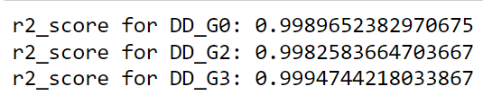
Results
Training Results

Slide 12
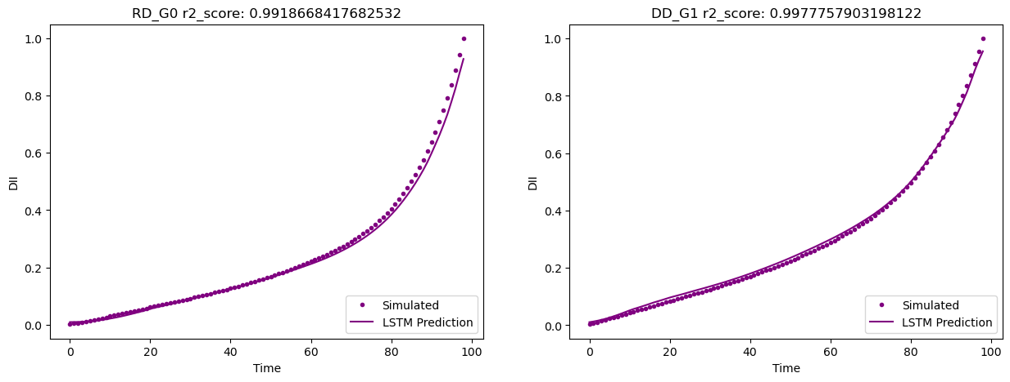
Preliminary Results
Testing Results

Slide 13
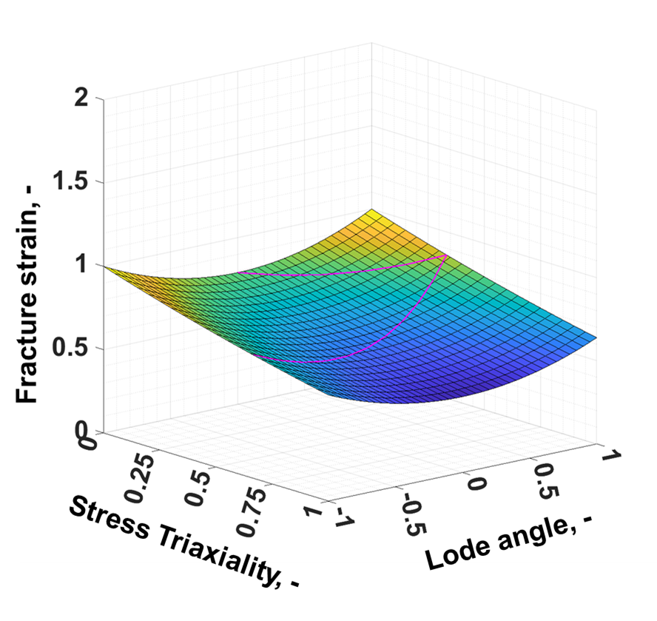

Case II: Damage parameters (D1, D2, D3, D4) identification using ANN
Constitutive model
Plasticity model
DII
Yield function = Flow potential:
Hardening function:
$$f=\overline{σ}−\left(1−D\right)∙σ_{Y}\left({\overline{ε}}^{P}\right)≤0$$
$$σ_{Y}\left({\overline{ε}}^{P}\right)=α∙A{\left({\overline{ε}}_{0}+{\overline{ε}}^{P}\right)}^{n}+\left(1−α\right)∙\left[k_{0}+Q\left(1−e^{−β{\overline{ε}}^{P}}\right)\right]$$
Damage locus
Fracture model
Damage initiation locus:
$${\overline{ε}}_{ddi}\left(η, \overline{θ}\right)=\left(D_{1}∙e^{−D_{2}∙η}−D_{3}∙e^{−D_{4}∙η}\right)∙{\overline{θ}}^{2}+D_{3}∙e^{−D_{4}∙η}$$
D1
D2
D3
D4

Slide 14
Database
Total 75 datasets from simulation: 60 for training, 15 for testing
Experimental force-displacement of 5 geometries for prediction
Simulation values @ fracture | Geometry
 | G0 | G1 | G2 | G3 | G4
Force |  | ✓ | ✓
Displacement | ✓ | ✓ | ✓
PEEQ | ✓ | ✓ | ✓
Triax | ✓ | ✓ | ✓
Lode
SMax
SMid
SMin
✓ Training
Testing
Prediction
80%
20%
Notes:
Zinan

Slide 15
ANN – Artificial Neural Network
Subset of machine learning
Mimics the human brain
Comprises of node layers: input layer, one or more hidden layers, output layer
node => artificial neuron
Accuracy depends greatly on training data
https://www.ibm.com/cloud/learn/neural-networks

Slide 16
ANN
How do neural networks work?
Each node consists of input, weights, bias and output
combination = weights * inputs + bias
activation function produces the output = > output = activation(combination)
Examples of activation functions include linear function, logistics function, rectified linear unit function (ReLU)
Weights are initially assigned randomly
Outputs from one layer serve as input to next layer :- feed-forward network
Training
  Loss function (e.g. mean squared error) to measure the model’s error in predictions
  Backpropagation: the output of the network is backpropagated and the weights and biases are updated based on the gradient of the loss function
  Optimization algorithms are used to optimize the weights and biases to minimise error

Slide 17
ANN
Inputs/Features: force, displacement, geometry (different versions with different inputs were tried)
Outputs/Labels: D1, D2, D3, D4
Data normalization
Hyperparameter tuning: to optimize right number of units per layer: Grid search
Number of epochs (total number of iterations of training data): 100
Batch size (number of data samples processed before adjusting weights and biases): 16
Activation function (function to evaluate the output of a node/unit): RelU
Loss function (function to evaluate how close the predicted and real outcomes are): Mean squared error
Input layer
(3 neurons)
1st hidden layer
(4 neurons)
ANN
Architecture
2nd hidden layer
(8 neurons)
Output layer
(4 neurons)

Slide 18
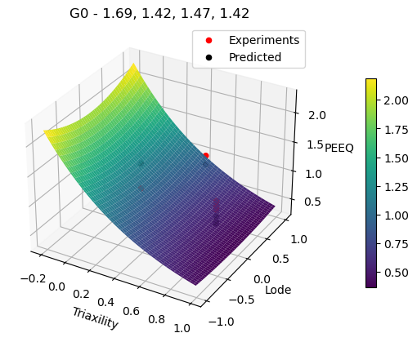
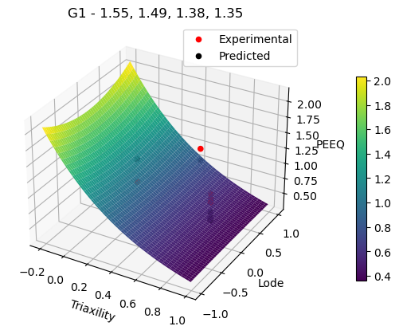


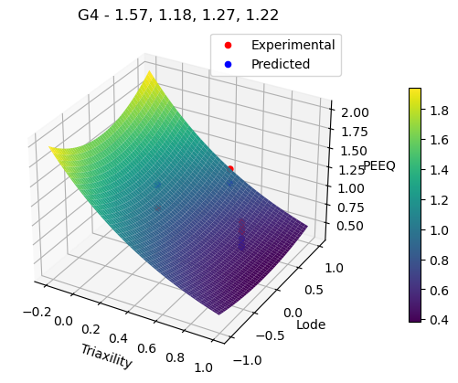
Results – Fracture Loci

Slide 19
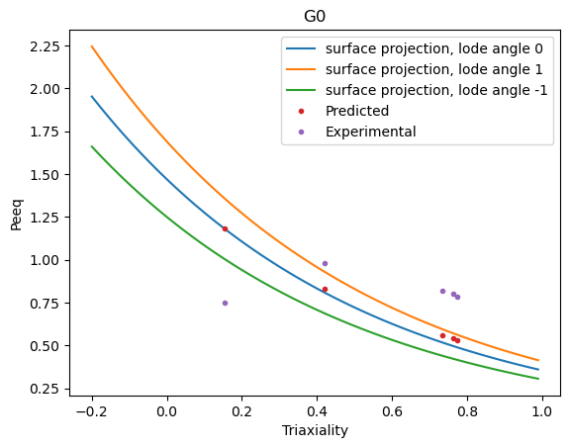
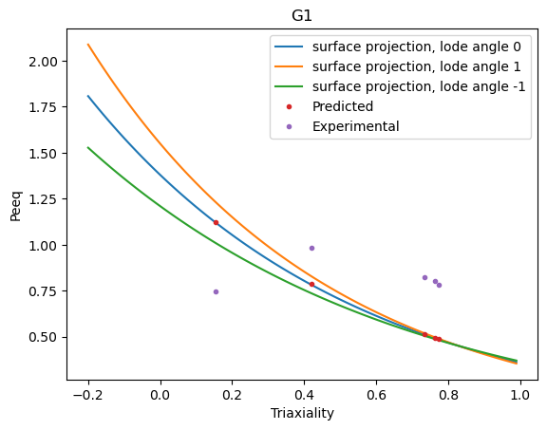
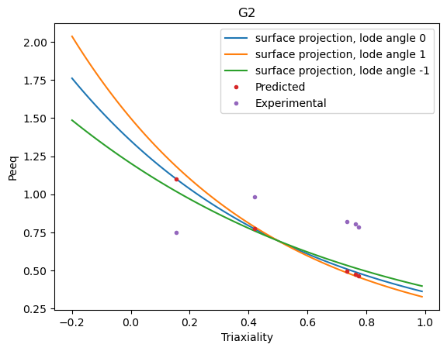
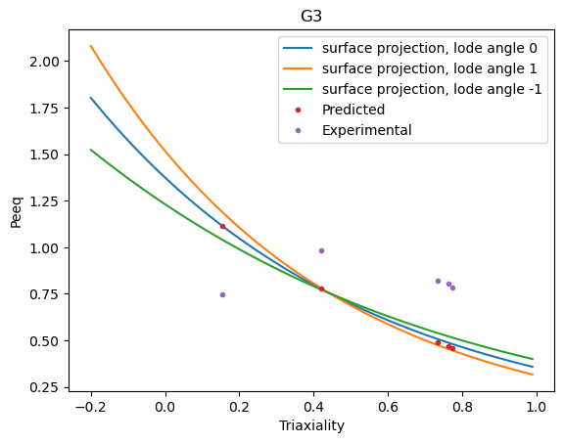
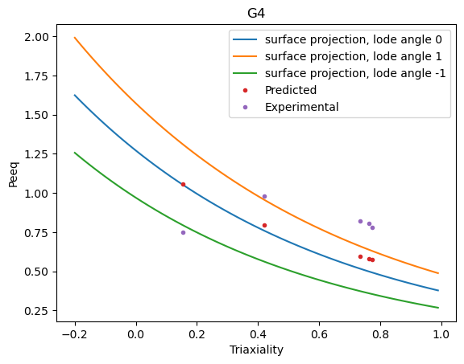
Results – 2D Surface Projections

Slide 20
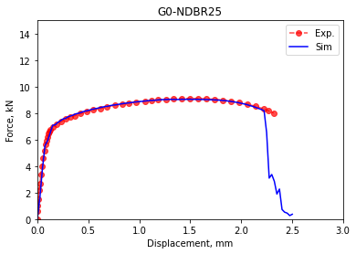
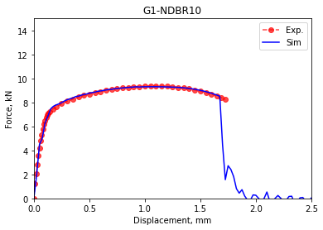
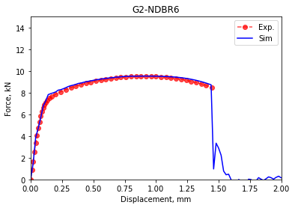
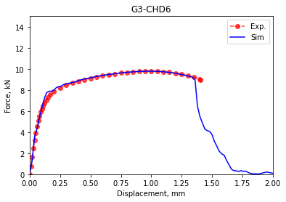
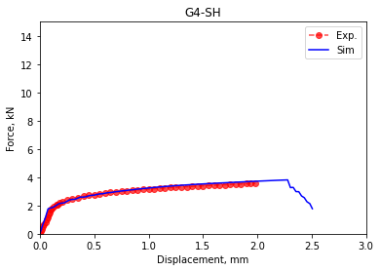
Results – Validation on Fracture Points

Slide 21
Outlooks
This study focuses on developing ML models to study the damage parameters
Prediction on damage parameter evolution is promising
Improvements has been made regarding the data engineering
Remove geometry labels – 1 out of 5
Enlarge training database (Two times)
Scaling output layer
Improve prediction on shear – evenly or higher weight
Literature review on the latest papers

